Slide 1
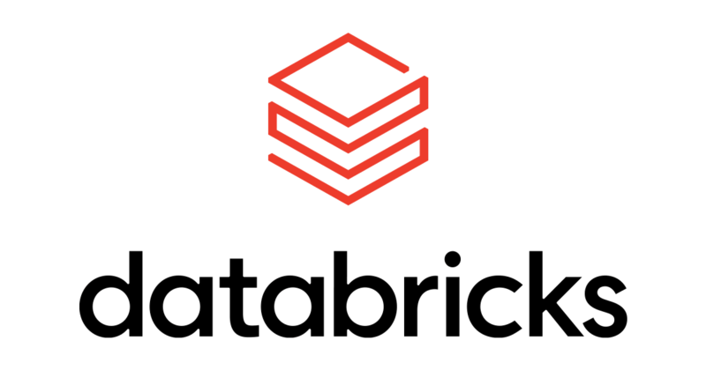
Welcome to
Training

Slide 2
Welcome to
Live Session

Slide 3


Naval Yemul Databricks Consultant & Instructor

Slide 4
Python
Data type
Int
Float
String
Bool
Complex

Slide 5
Data structure
List
Tuple
Set
Dict
Range

Slide 6
BigData: PySpark
Naval Yemul

Slide 7
Big Data
Big data is data that contains greater variety, arriving in increasing volumes and with more velocity. This is also known as the 3’Vs.
Few Eg:
Amount of data generating per day
1. You Tube: Every hour 30 hours of videos are uploading.
2.In New York Stock Exchange
3.Social Media
4.Jet Engine
2.5 Quintillions(18 Zeros) Bytes of Data created every day.
Naval Yemul

Slide 8
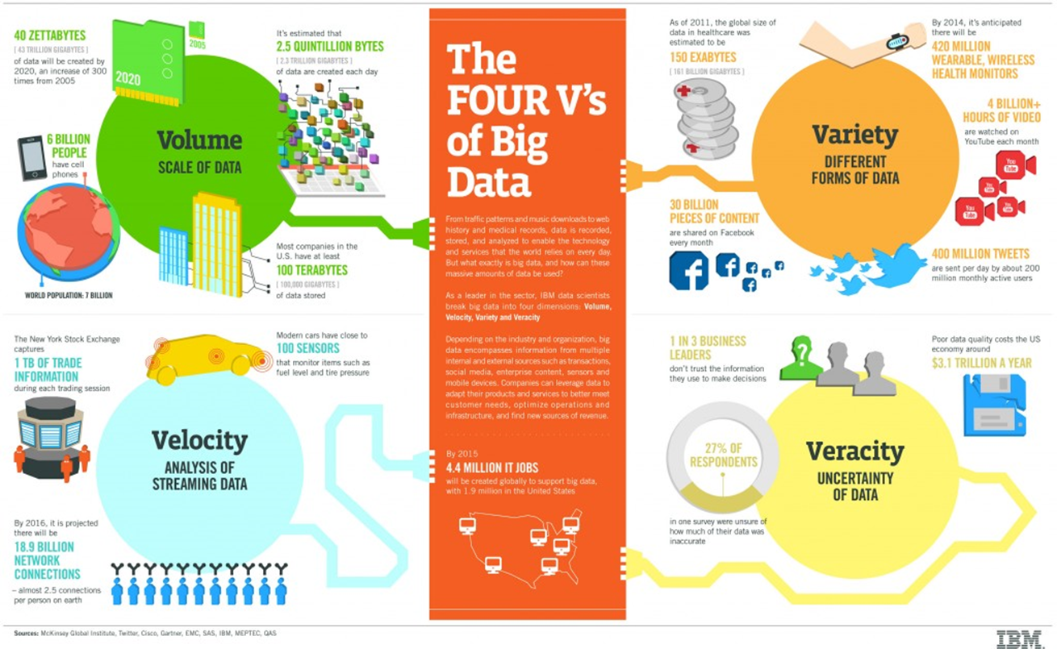
Naval Yemul

Slide 9
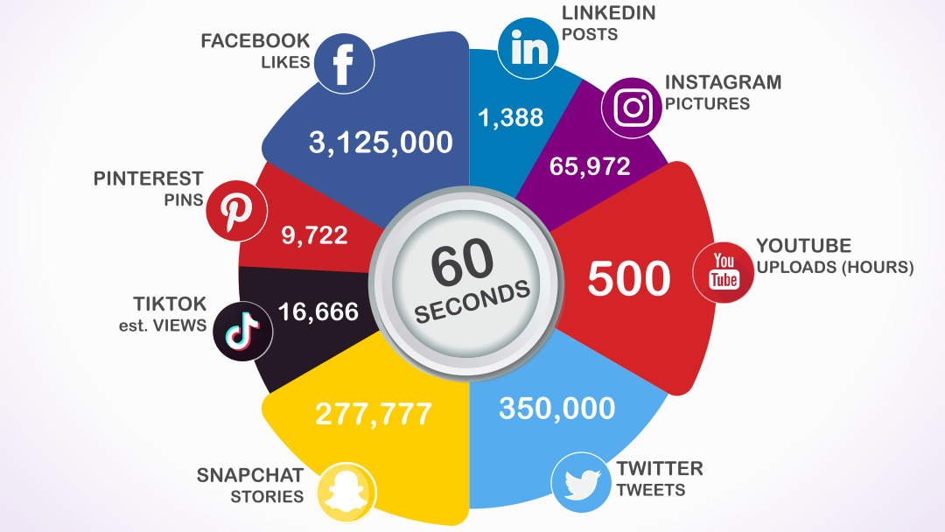
Naval Yemul

Slide 10
Forms of Big Data
•Structured
•Semi structured
•Unstructured data
 | Structured | Semi Structured | Unstructured data
Examples | 1.Excel Spreadsheet 2.CSV File 3.Relational Database | 1. (HTML) files 2. (JSON) files 3. (XML) files | 1.Images 2.Videos 3.Audio 4.Plain text files 5.Word files 6.PDF files
Naval Yemul

Slide 11
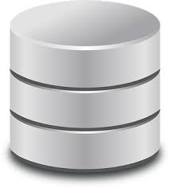
Why Big Data?
Store.
To process huge amount of data we first need to store it.
Are Traditional systems fit to store such huge amount of data?
Naval Yemul

Slide 12
Store
Store massive amount of data
Process
Process it in timely manner
Scale
Scale easily as data grows
Naval Yemul

Slide 13
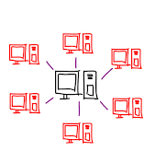

Monolithic System
Distributed System
Naval Yemul

Slide 14
Resources
RAM 16 Gb(Memory),
Hard Disk 1Tb(Storage),
CPU Quad Core (Compute)
Naval Yemul

Slide 15

Hadoop
Hadoop is a framework to solve Bigdata problems ​
Apache Hadoop is one of the most popularly used tools in the Big Data industry.​
Hadoop is an open-source framework from Apache and runs on commodity hardware. It is used to store process and analyze Big Data.
Naval Yemul

Slide 16
Hadoop Evolution
2003:
Google released a paper to describe how to store large datasets
On distributed Storage
This paper was called as GFS(Google File System)
2004:
Google released another paper to describe how to process large datasets
On processing
This paper was called MapReduce.
2006:
Yahoo took these papers and implemented it.
The implementation of GFS was named as HDFS(Hadoop Distributed File System)
The implementation of MapReduce was named as MapReduce.
Naval Yemul

Slide 17
Hadoop 1.0
MapReduce
HDFS
Naval Yemul

Slide 18
2009. Hadoop came under Apache Software Foundation and become open source
2013
Hadoop released 2.0
The Apache Software Foundation is an American nonprofit corporation to support a number of open source software projects.
THE WORLD'S LARGEST OPEN SOURCE FOUNDATION
Naval Yemul

Slide 19
Hadoop 1.0
Hadoop 2.0
MapReduce
MapReduce
YARN
HDFS
HDFS
Naval Yemul

Slide 20
YARN
Yet Another Resource Negotiator
Mainly responsible for Resource Management
Naval Yemul

Slide 21
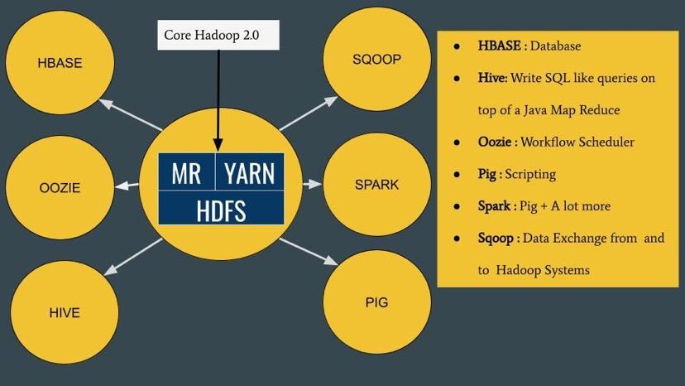
Naval Yemul

Slide 22



Big Data Tools
Figure: Various Big data tools
Naval Yemul

Slide 23
Hadoop
Apache Hadoop is one of the most popularly used tools in the Big Data industry.
Hadoop is an open-source framework from Apache and runs on commodity hardware. It is used to store process and analyze Big Data.
Naval Yemul

Slide 24
Apache Spark
Spark can be considered as the successor of Hadoop as it overcomes the drawbacks of it. Spark, unlike Hadoop, supports both real-time as well as batch processing. It is a general-purpose clustering system.
It also supports in-memory calculations, which makes it 100 times faster than Hadoop. This is made possible by reducing the number of read/write operations into the disk.
It offers high-level APIs in Java, Python, Scala and R.
Spark also offers a substantial set of high-level tools including
Spark SQL, MLlib, GraphX, and Spark Streaming.
Naval Yemul

Slide 25
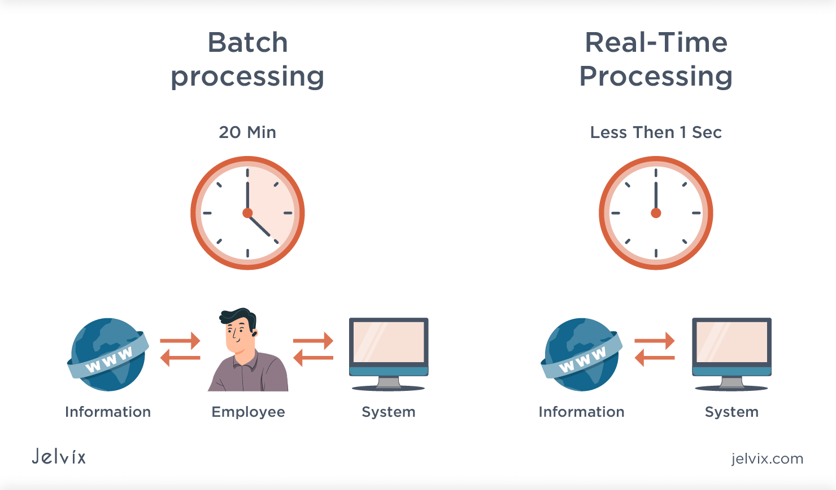
Apache Spark
Unifies
Batch processing
Real Time processing
Stream Analytics
Machine Learning
Interactive SQL
Figure: Batch processing vs Real Time processing
Naval Yemul

Slide 26

Hadoop vs Spark
Hadoop | Spark
Yahoo Project in 2006 | AMP Lab at UC Berkeley in 2012
Faster than traditional system | 100 times faster than Hadoop
Lengthy and complex framework | Simple and user friendly system
Hadoop is designed to handle batch processing efficiently | Spark is designed to handle both batch and real-time data efficiently
Table: Hadoop vs Spark
Naval Yemul

Slide 27
Hadoop vs Spark
Hadoop | Spark
Hadoop is an open source framework which uses a MapReduce algorithm | Spark is lighting fast cluster computing technology, which extends the MapReduce model to efficiently use with more types of computations
Hadoop MapReduce model reads and writes from a disk, thus slow down the processing speed | Spark reduces the number of read/write cycles to disk and store intermediate data-in memory, hence faster processing speed
Low Cost | High Cost
Table: Hadoop vs Spark
Naval Yemul

Slide 28
History of Spark
Apache Spark started in 2009 as a research project at UC Berkley’s AMP Lab, a collaboration involving students, researchers, and faculty, focused on data-intensive application domains.
Today, Spark has become one of the most active projects in the Hadoop ecosystem, with many organizations adopting Spark alongside Hadoop to process big data.
Naval Yemul

Slide 29
On Premise
Hadoop
Java
Spark
Python
Set up environment.
Azure (HD Insight/Spark/Synpase)
Aws (EMR)
GC
Microsoft Fabric
Databricks

Slide 30
Features
1. Lightning-fast processing speed
2. Ease of use
3. Real-time stream processing
4. Active and expanding community
Naval Yemul

Slide 31

PySpark
Naval Yemul

Slide 32

Spark's Basic Architecture
Figure: Spark Architecture
Naval Yemul

Slide 34
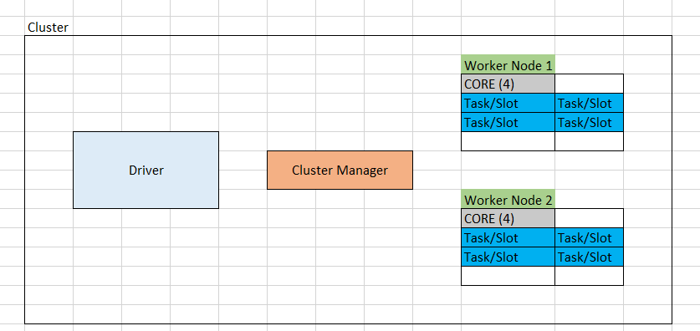
Spark's Architecture
Figure: Spark Architecture
Naval Yemul

Slide 35
Cluster Manager
Standalone – a simple cluster manager included with Spark that makes it easy to set up a cluster.
Apache Mesos – a general cluster manager that can also run Hadoop MapReduce and service applications.
Hadoop YARN – the resource manager in Hadoop 2.
Kubernetes – an open-source system for automating deployment, scaling, and management of containerized applications.
Naval Yemul

Slide 36

Application A1
Executor
Driver
spark-submit
Executor
Client Machine
Cluster
Naval Yemul

Slide 37
Application A1
Executor
Driver
spark-submit
Executor
Application A2
Executor
Driver
spark-submit
Client Machine
Executor
Cluster
Naval Yemul

Slide 38
Executor
Driver
Analysing
Distributing
Scheduling
Monitoring
Executor
Executor
Driver
Client Machine
Executor
Cluster
Naval Yemul

Slide 39
Who Executes where?
Client Mode
Cluster Mode
Executor
Executor
Client Machine
Cluster

Slide 40
Who Executes where?
Client Mode
Cluster Mode
Executor
Executor
Client Machine
Cluster

Slide 41

Who Executes where?
1. Client Mode
Executor
Driver
Executor
Client Machine
Cluster

Slide 42
Who Executes where?
2. Cluster Mode
Executor
Driver
Executor
Client Machine
Cluster

Slide 43
Spark JVM
Driver
Executor
Local Machine

Slide 44
Summary
Spark creates one drive and bunch of executors for each application
Spark offers two deployment mode for an application
Client Mode: Driver on client machine and executor on cluster
Cluster Mode: Driver and executor on cluster

Slide 45
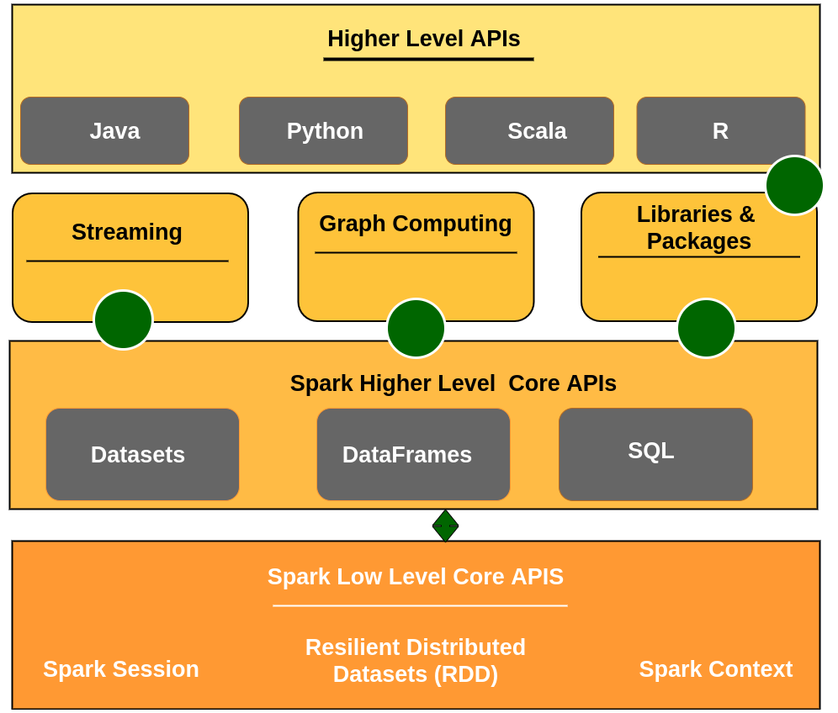
Spark’s Toolset
Figure: Spark Toolset

Slide 46
Spark Components
DataFrame | Spark SQL | Spark Streaming | Mlib (Machine Learning) | GraphX (Graph)
Spark Core
Figure: Spark Components

Slide 47
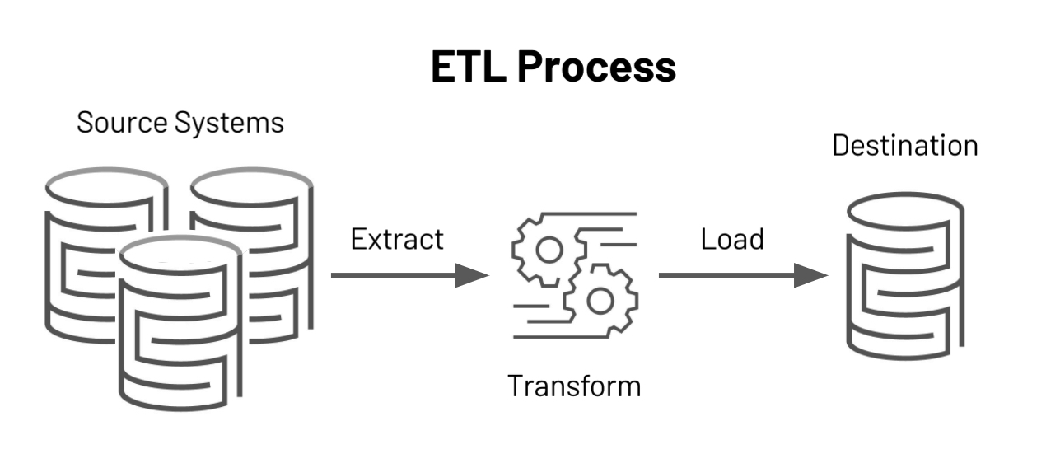
RDD, Dataframe and Dataset
RDD
DataFrame
Dataset

Slide 48
2013
2015
DataFrame
Dataset
RDD
2011

Slide 49
RDD
Resilient Distributed Dataset (RDD)
Spark RDD is resilient, partitioned, distributed and immutable collection of data.
Collection of data: RDD holds data and appears to be a Scala collection
Resilient: RDD’s are fault tolerant.
Partition: Spark breaks the RDD into smaller chunks of data. These pieces are called partitions.
Distributed: Spark distributes these partitions across the cluster.
Immutable: Once defined you can’t change them.

Slide 50
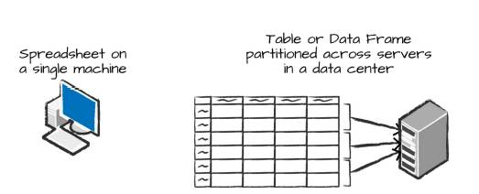
DataFrame
A DataFrame is the most common Structured API and simply represents a table of data with rows and columns.
Similar to database table
The list that defines the columns and the types within those columns is called the schema.
Figure : Distributed versus single machine analysis.

Slide 51
 | RDD | Data Frame | Dataset
version | 1.0 | 1.3 | 1.6
Data Representation | Distributed collection of elements | Distributed collection of data organized into column | Combination of RDD & DF
Data formats | Structured and unstructured | Structured and semi Structured | Structured and unstructured
Optimization | No built in optimization engine. | Query optimization through the catalyst optimizer | Query optimization through the catalyst optimizer, like DF
Programming Language | Java Scala Python R | Java Scala Python R | Java Scala
Aggregations | Hard, slow to perform | Fast for exploratory analysis. Quick | Fast for exploratory analysis. Quick
 |  |  | Combine the performance optimization of DF and convenience of RDD
 |  | Untyped: Python and R | (Strongly Typed API)- Java and Scala

Slide 52
Spark Context
SparkContext is the entry point of Spark functionality.
It is used to communicate with cluster and to create RDD
The most important step of any Spark driver application is to generate SparkContext.
It allows your Spark Application to access Spark Cluster with the help of Resource Manager.
The resource manager can be one of these three- Spark Standalone, YARN, Apache Mesos.

Slide 53
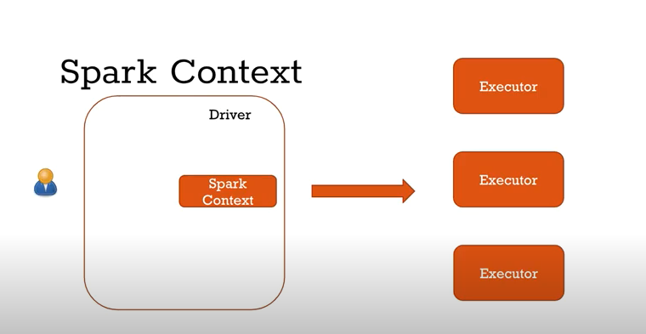
Spark Context
Note: You can create only one SparkContext per JVM, in order to create another first you need to stop the existing one using stop() method

Slide 54
Creating Spark Context
import pyspark
from pyspark import SparkContext
conf=pyspark.SparkConf().setMaster("local").setAppName("My first Spark")
sc=SparkContext(conf=conf)
sc.getConf().getAll()

Slide 55
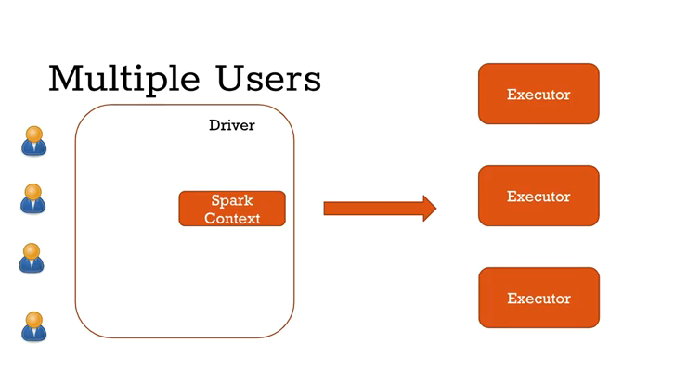

Slide 56
Spark Session
Since Spark 2.0
Spark application is controlled by driver process called Spark Session.
Spark Session is an entry point to underlying Spark functionality in order to programmatically create Spark RDD, DataFrame, and Dataset.

Slide 57
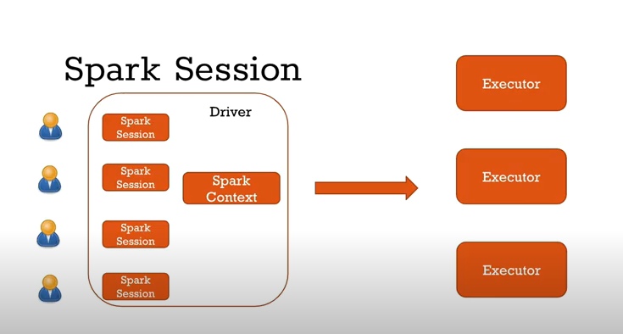

Slide 58
Creating Spark Session
# Create SparkSession from builder
import pyspark
from pyspark.sql import SparkSession
spark = SparkSession.builder.master("local[1]") \
.appName('SparkByExamples.com') \
.getOrCreate()
It’s object spark is default available in spark-shell and it can be created programmatically using SparkSession builder pattern.

Slide 59
Transformation
Transformations instruct the Spark cluster to perform changes to the DataFrame.
These are further categorized into narrow transformations and wide transformations.
Wide transformations lead to the shuffling of data as data requires movement across executors, whereas narrow transformations do not lead to re-partitioning across executors.

Slide 60
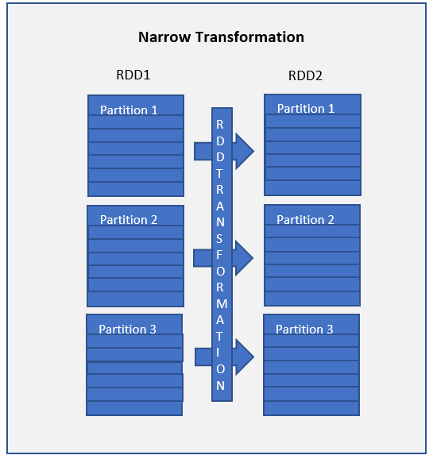
Narrow transformations are the result of map() and filter() functions
Functions such as map(), mapPartition(), flatMap(), filter(), union() are some examples of narrow transformation

Slide 61
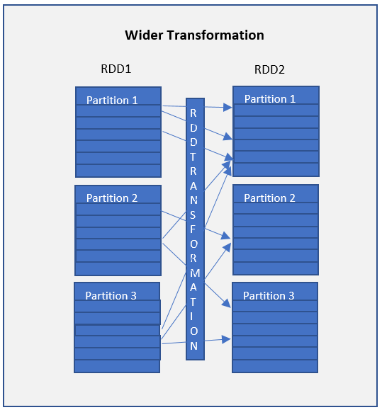
Wider transformations are the result of groupByKey() and reduceByKey() functions
Functions such as groupByKey(), aggregateByKey(), aggregate(), join(), repartition() are some examples of a wider transformations.

Slide 62



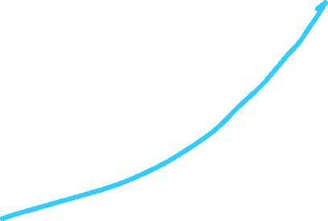





























Slide 63












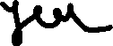









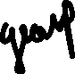









Slide 65
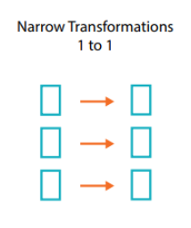
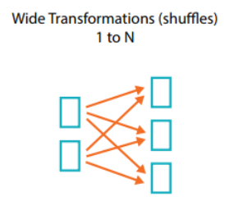

Slide 66
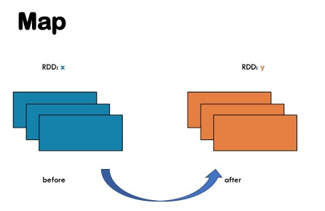

Slide 67
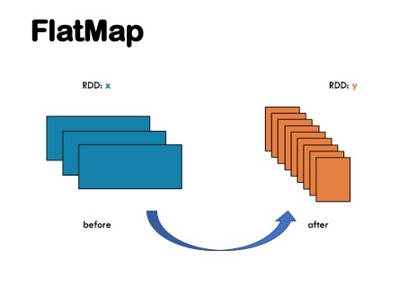

Slide 68
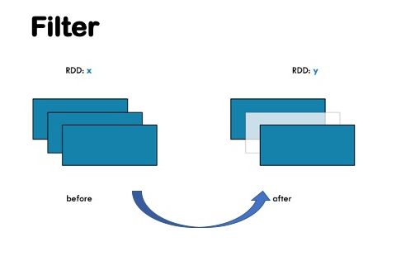

Slide 69
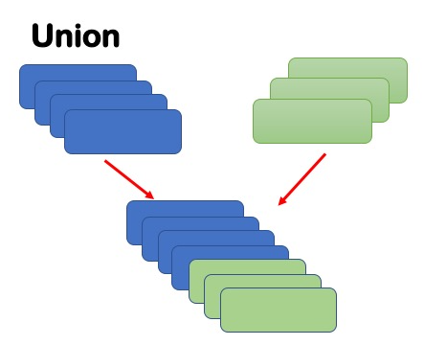

Slide 70
Lazy Evaluation
Transformations does not make the Spark cluster do anything. It is only when an action is called that the Spark cluster begins execution, hence the saying Spark is lazy.
Before executing an action, all the Spark makes a data processing plan. We call this plan the Directed Acyclic Graph (DAG).

Slide 71
Actions
Transformations allow us to build up our logical transformation plan. To trigger the computation, we run an action.
Actions instructs Spark to perform computation and send the result back to driver.

Slide 72
Examples of Transformations and Actions
Transformations | Actions
spark.read() | .count()
.where() | .collect()
.join | .take()
.write() | .show()

Slide 73
Steps for installing Spark in Local
Install Java version JDK
Install Python 3
Download and Extract Apache Spark
Setting Environment variables for Java, Python and PySpark
Installing winutils
Configuring the log level for Spark
Create conda environment

Slide 74
Installing Spark in Local Environment
winutils.exe file, which is an Hadoop component for Windows OS.

Slide 75
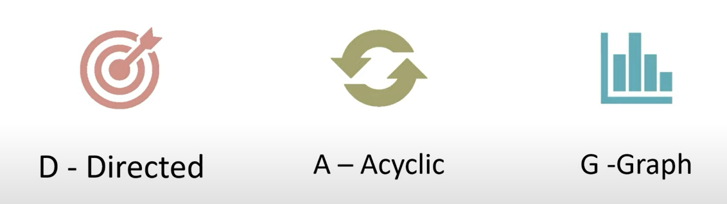
DAG
D- Directed
A- Acyclic
G- Graph

Slide 76

Spark DAG
It is logical flow of operations
A job is associated with a chain of RDD dependencies organized in a DAG.

Slide 77
Vertices represent the RDDs and the edges represent the operation to be applied on RDD
Operation 2.1
Operation 1
Operation 3
Operation 2.2

Slide 78
Why are DAG needed
Most optimised plan
Minimize shuffling
Fault Tolerance
RDD recovery

Slide 79
How DAGs work
RDD has 2 types of transformation
Narrow
Wide
When an action is encountered
Spark creates the DAG and submits it to the DAG scheduler
DAG scheduler splits the graph into multiple stages
Stages are created based on the transformations
Narrow transformations will be grouped (Pipe Lined together) into a single stage.
DAG scheduler will then submit the stages into the task scheduler.

Slide 80
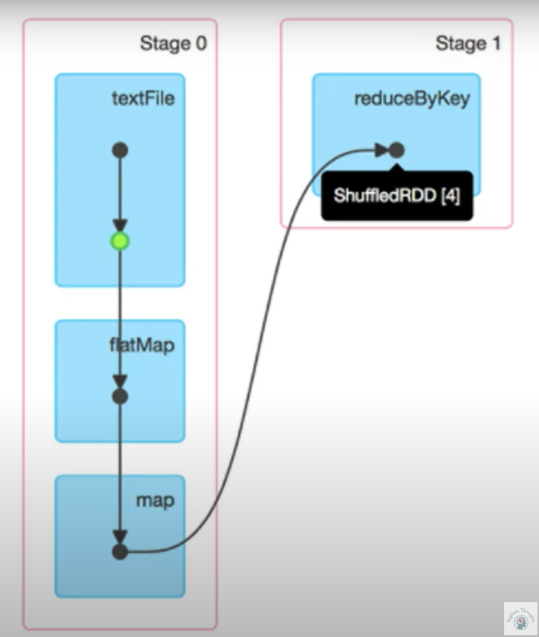
DAG Visualization
Blue Box- Spark Operation
Black Dots- RDDs created
Green Dot- Cached RDD in stage

Slide 81
Stage 4
Task 6
Job 2
Stage 3
Task 5
Task 4
Stage 2
Hello Spark
Task 3
Job 1
Stage 1
Task 2
Job 0
Stage 0
Task 1
Task 0

Slide 82
Spark Optimization
Cache
Persist

Slide 83
Spark Memory Management
Spark is a memory based data processing framework hence memory plays a central role.
Efficient memory usage is key to good performance therefore it is important to understand how spark does memory management.

Slide 84
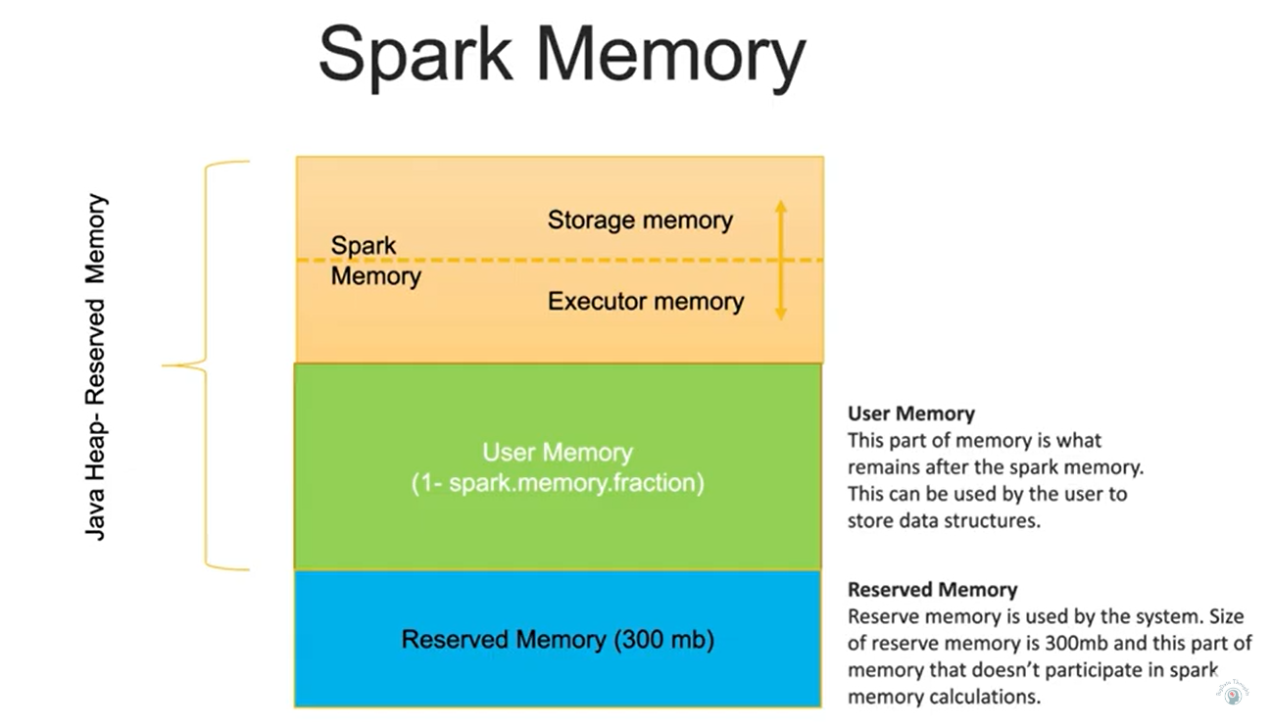

Slide 85
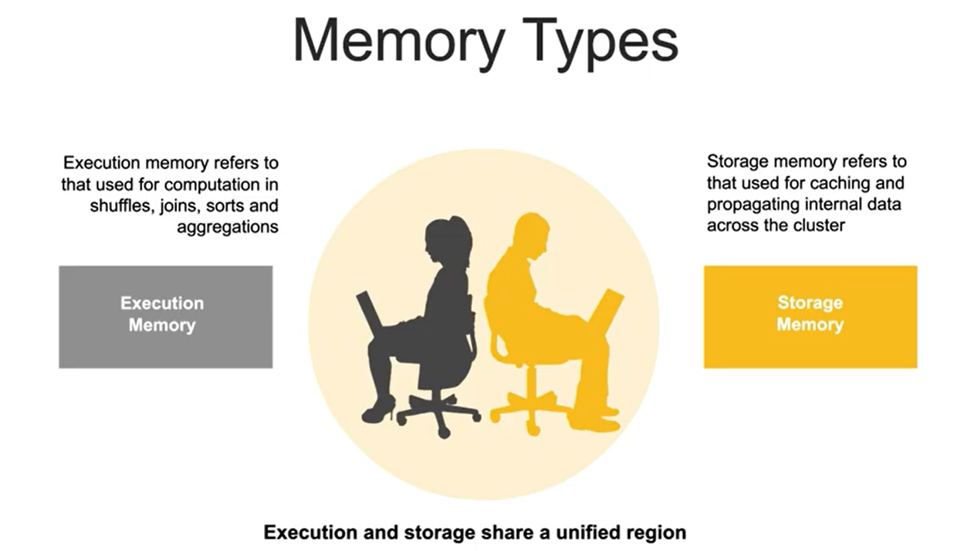

Slide 86
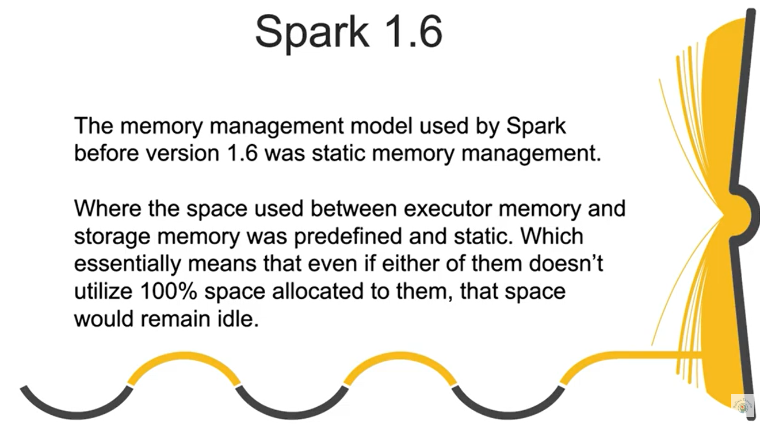

Slide 87
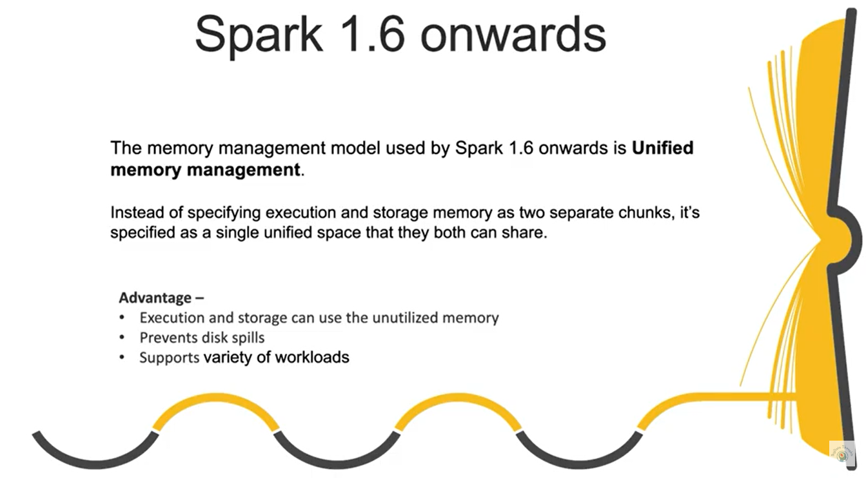

Slide 88
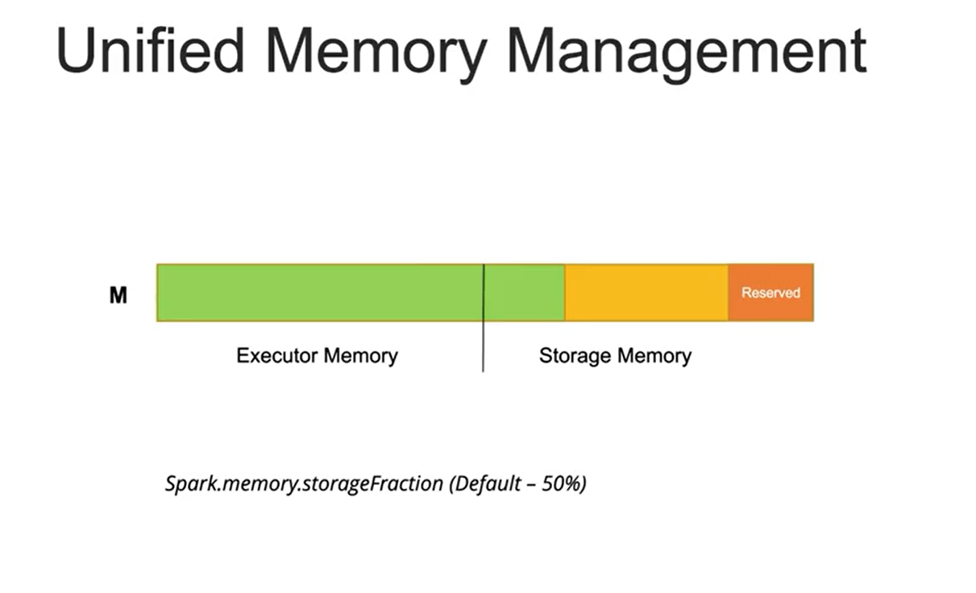

Slide 89
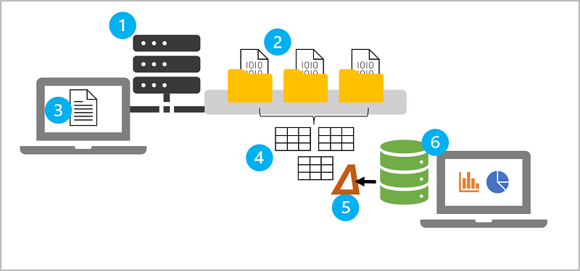
https://learn.microsoft.com/en-gb/training/modules/explore-azure-databricks/04-key-concepts

Slide 90
Azure Storage Account
Blob Storage (Binary Large Object)
ADLS Gen 2 (Hierarchal Namespace)

Slide 91
Azure Data Factory
ETL / ELT cloud based (low code tool or no code tool)

Slide 92






Components of ADF
Linked Service
Dataset
Activities
Pipeline
Integration Runtime

Slide 93












Slide 94



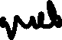






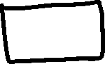







Slide 95












Slide 97

What is Databricks?
With origins in academia and the open source community, Databricks was founded in 2013 by the original creators of Apache Spark, Delta lake, ML flow and Unity Catalog.
Data + AI
Today, more than 16000 organizations worldwide rely on Databricks to enable massive scale data engineering collaborative data science, full lifecycle machine learning and business analytics.
16000 +

Slide 98
Discovering Databricks
The Original creators of Apache Spark established Databricks to solve the worlds toughest data problems.
Databricks was launched as a Spark based unified data analytics platform in the cloud.

Slide 99
Introduction to Databricks
Databricks was launched as a Spark-based unified data analytics platform in the cloud.
Databricks provides a collaborative platform for data engineering and data science.
It has also revolutionized the existing data lakes by introducing the Lakehouse architecture.

Slide 100
Any industry that uses data has something Databricks can offer
Data engineer
Data scientist
Data analyst
Business intelligence analyst

Slide 101
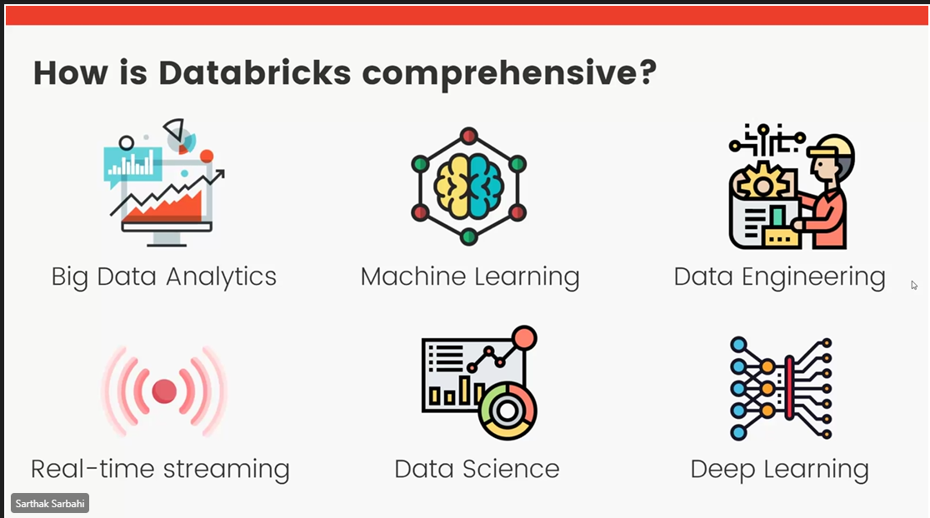

Slide 102
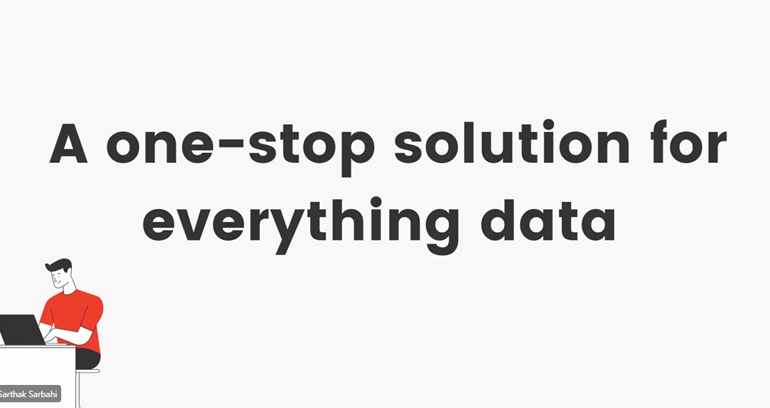

Slide 103
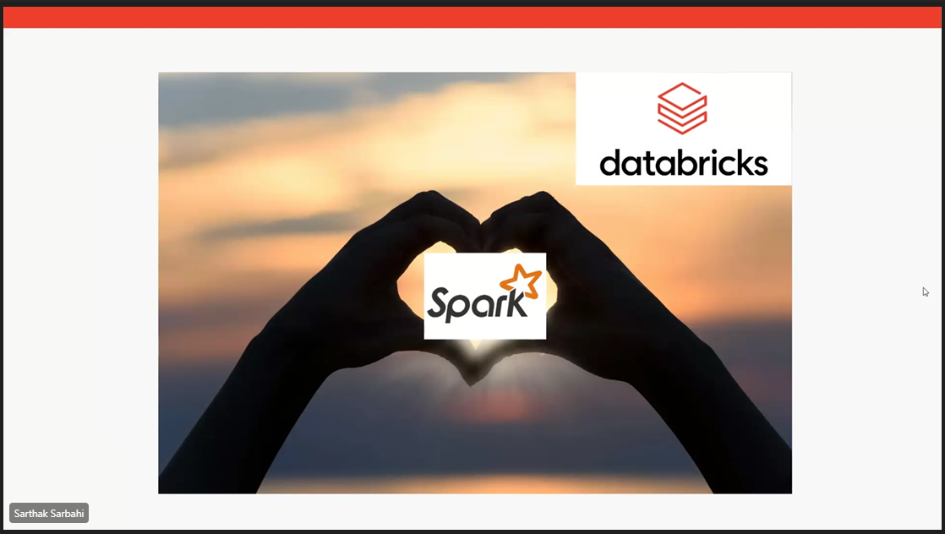

Slide 104
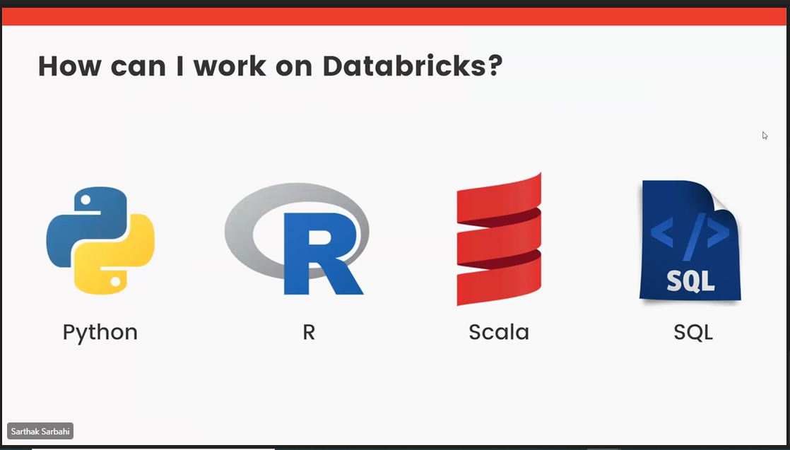

Slide 105
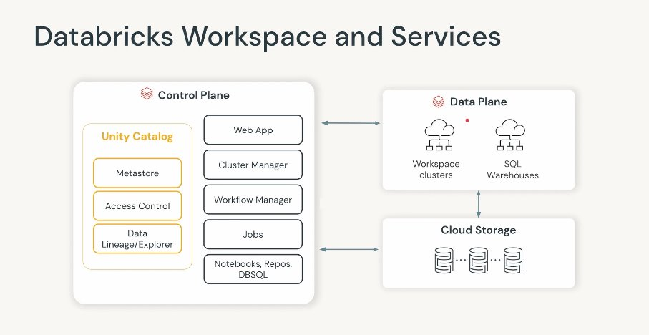

Slide 106
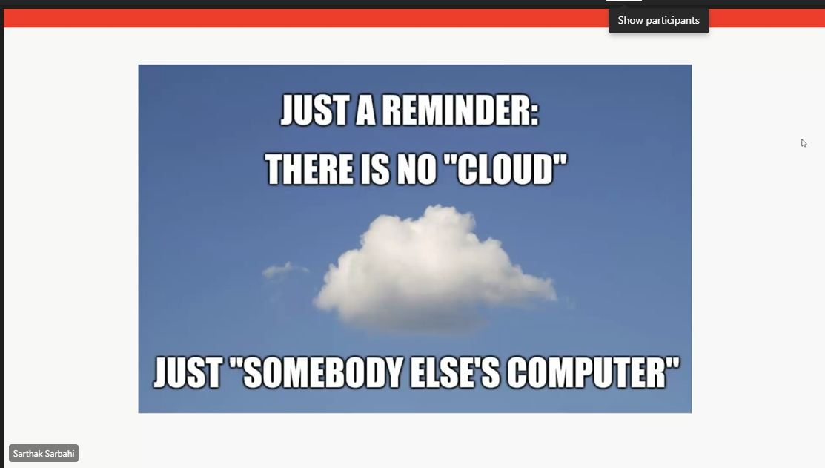

Slide 107
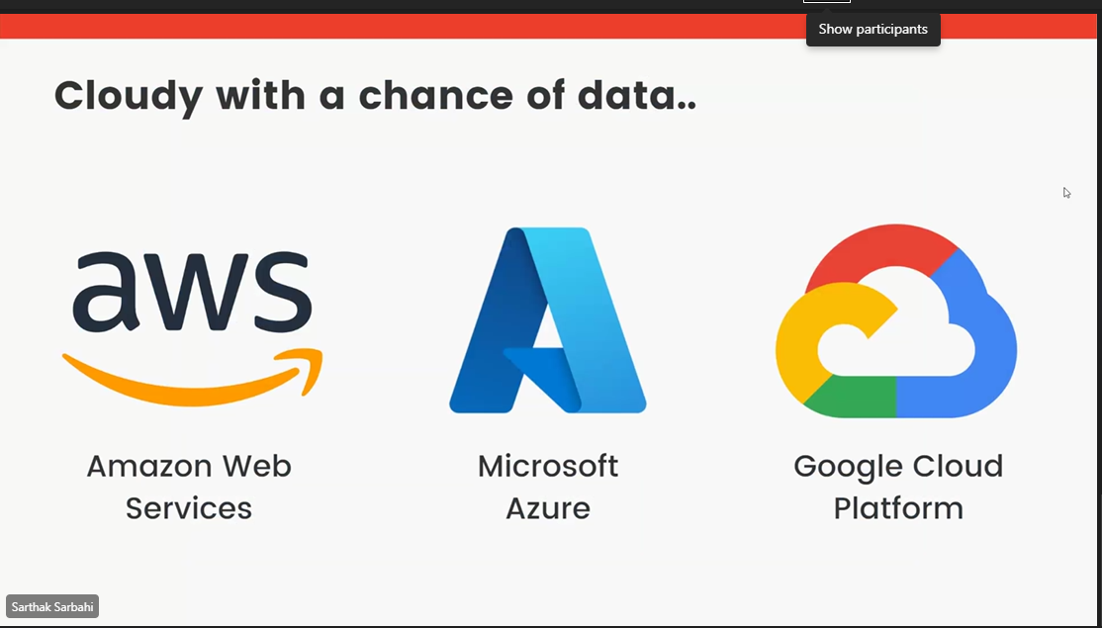

Slide 108
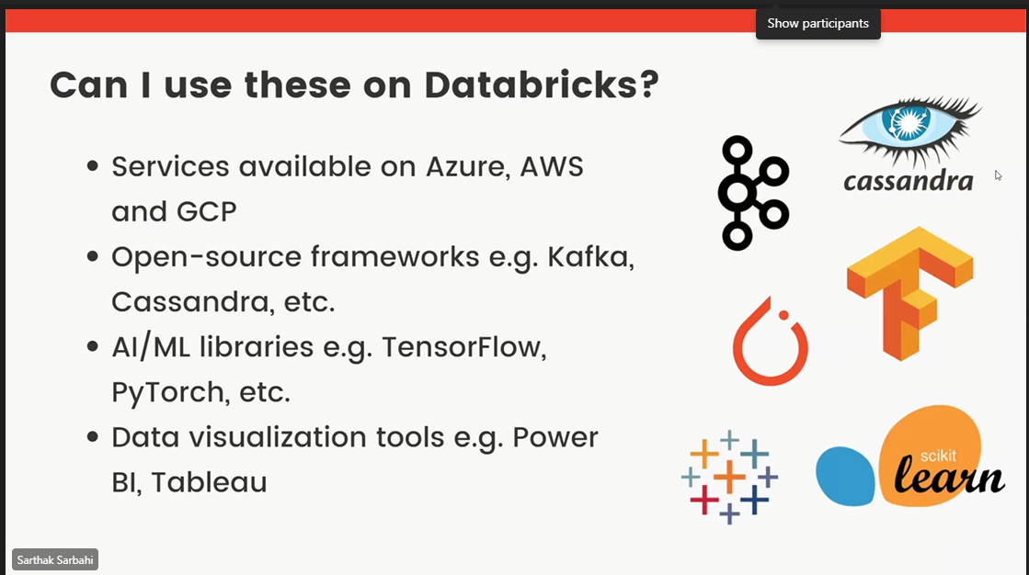

Slide 109
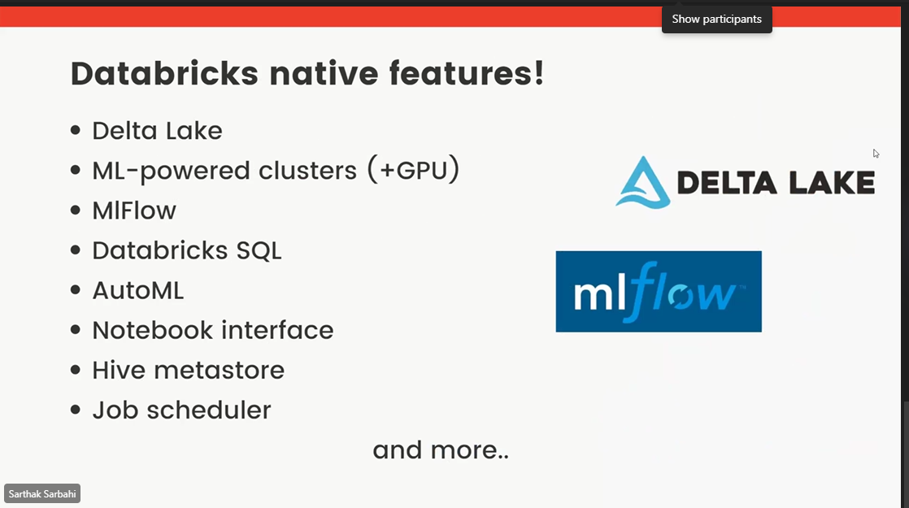

Slide 110
Row Based (CSV, TSV and Avro)
 | Id | Name | State | Age
Row 1 | 100 | Albert | German | 40
Row 2 | 101 | John | United Kingdom | 50
Row 3 | 102 | Peter | United States of America | 39
Row 4 | 103 | Raman | Indian | 55
Columnar (Parquet, Delta and ORC)
 | Row 1 | Row 2 | Row 3 | Row 4
Id | 100 | 101 | 102 | 103
Name | Albert | John | Peter | Raman
State | German | United Kingdom | United States of America | Indian
Age | 40 | 50 | 39 | 55
Naval Yemul

Slide 112

Naval Yemul

Slide 113
Delta Lake
Open-source storage framework that brings reliability to data lakes
Naval Yemul

Slide 114
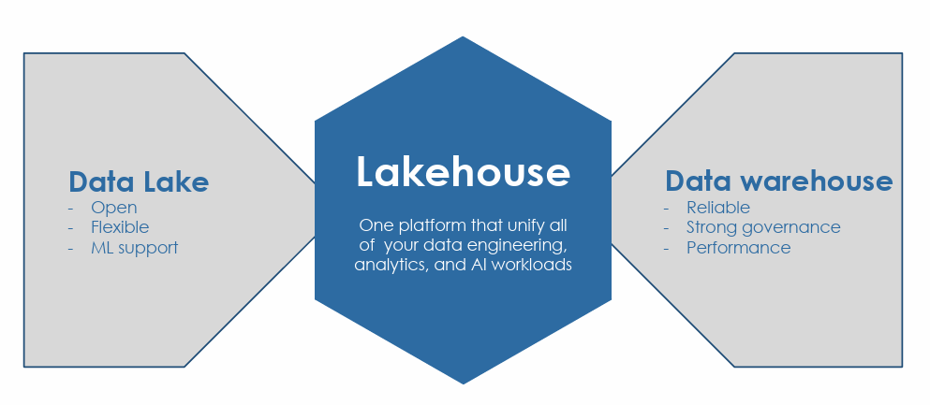
Lakehouse

Slide 115
Delta Lake
Data Warehouse | Data Lake | Lakehouse(Delta Lake)
Only structured Data | Structured/semi-structured/unstructured | Structured/semi-structured/unstructured/streaming
Schema-on-write | Schema-on-read | Schema-on-read
Support ACID transaction | Minimal support to ACID transaction | Supports ACID transaction
Does not corrupt the system | Leaves system in corrupted state | Does not corrupt the system

Slide 116

Delta Lake brings ACID to object storage
Atomicity means all transactions either succeed or fail completely
Consistency guarantees relate to how a given state of the data is observed by simultaneous operations
Isolation refers to how simultaneous operations conflict with one another. The isolation guarantees that Delta Lake provides do differ from other systems
Durability means that committed changes are permanent

Slide 117
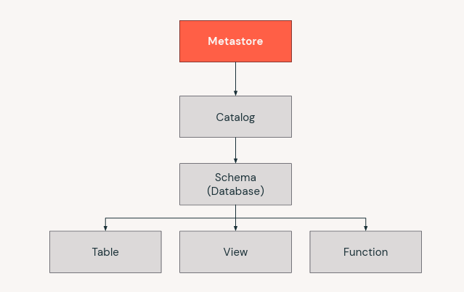
Data objects in the Lakehouse
Naval Yemul

Slide 118
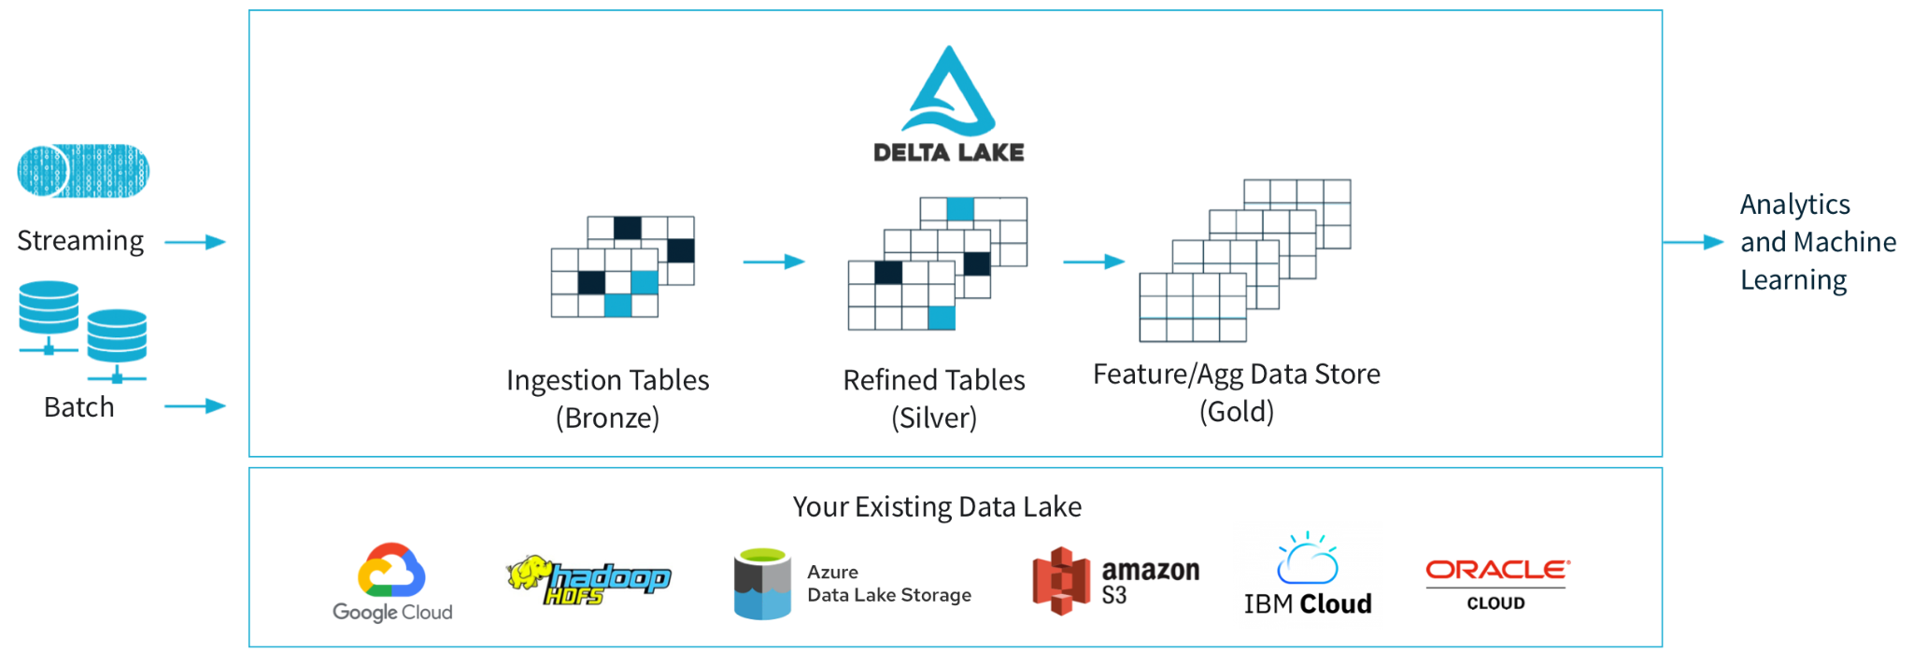
Multihop Architecture
Naval Yemul

Slide 119
Delta Lake is/is not
Is
Open-source technology
Storage framework/layer
Enabling building Lakehouse
Is Not
Proprietary technology
Storage format/medium
Data warehouse/Database
service
Naval Yemul

Slide 120
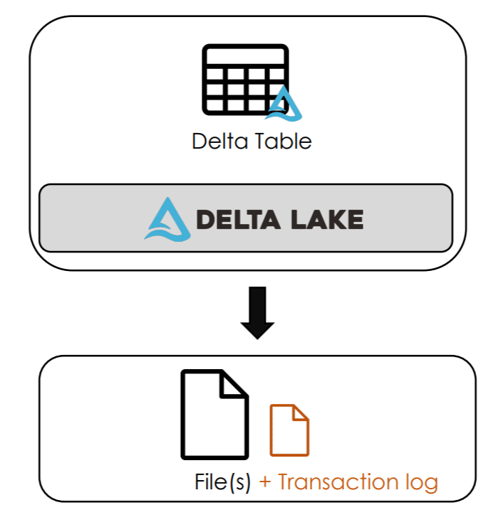
Storage
Cluster
Naval Yemul

Slide 121
Transaction log (Delta log)
Ordered records of every transaction performed on the table
Single Source of Truth
JSON file contains commit information:
Operation performed + Predicates used
data files affected (added/removed)
Naval Yemul

Slide 122
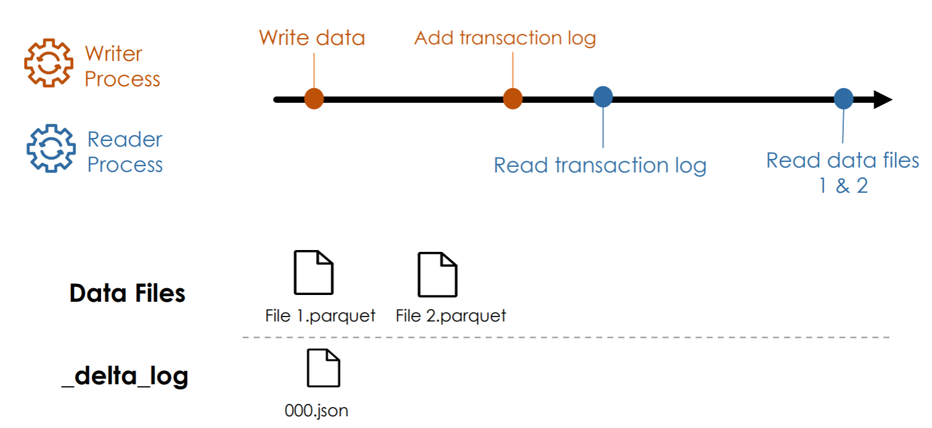
Writes/Reads
Naval Yemul

Slide 123
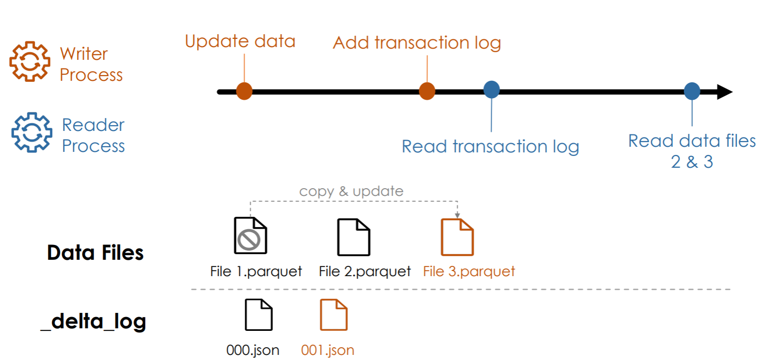
Updates
Naval Yemul

Slide 124

Simultaneous Writes/Reads
Naval Yemul

Slide 125

Failed Writes
Naval Yemul

Slide 126
Delta Lake Advantages
Brings ACID transactions to object storage
Handle scalable metadata
Full audit trail of all changes
Builds upon standard data formats: Parquet + Json
Naval Yemul

Slide 127
Mount ADLS container to Databricks
Create Service Principal
Create Azure Data Lake Storage Gen 2
Creating Azure Key Vault
Creating Databricks secret scope
Naval Yemul

Slide 128
AutoLoader
Auto Loader incrementally and efficiently processes new data files as they arrive in cloud storage without any additional setup.
Naval Yemul

Slide 129

Structured Streaming
Naval Yemul

Slide 130
Structured Streaming
Data Stream​
Any data source that grows over time​
New files landing in cloud storage​
Updates to a database captured in a CDC feed​
Events queued in a pub/sub messaging feed​
Naval Yemul

Slide 131
Learning Objectives
Process streaming data
DataStreamReader
DataStreamWriter
Naval Yemul

Slide 132
Processing Data Stream
Reprocess the entire source dataset each time
Only process those new data added since last update Structured Streaming
Naval Yemul

Slide 133

Spark Structured Streaming
Naval Yemul

Slide 134

Treating Infinite Data as a Table
Naval Yemul

Slide 135

Input Streaming Table
streamDF.writeStream
.trigger(processingTime="2 minutes")
.outputMode("append")
.option("checkpointLocation", "/path")
.table("Output_Table")
streamDF = spark.readStream .table("Input_Table")
Naval Yemul

Slide 136

Trigger Intervals
streamDF.writeStream
.trigger(processingTime="2 minutes")
.outputMode("append")
.option("checkpointLocation", "/path")
.table(”Output_Table")
Naval Yemul

Slide 137

Output Modes
streamDF.writeStream
.trigger(processingTime="2 minutes")
.outputMode("append")
.option("checkpointLocation", "/path")
.table(”Output_Table")
Naval Yemul

Slide 138
Checkpointing
Store stream state
Track the progress of your stream processing
Can Not be shared between separate streams
streamDF.writeStream
.trigger(processingTime="2 minutes")
.outputMode("append")
.option("checkpointLocation", "/path")
.table(”Output_Table")
Naval Yemul

Slide 139
Guarantees
1.Fault Tolerance
Checkpointing + Write-ahead logs
record the offset range of data being processed during each trigger interval.
2. Exactly-once guarantee
Idempotent sinks
Naval Yemul

Slide 140
Unsupported Operations
Some operations are not supported by streaming DataFrame
Sorting
Deduplication
Advanced methods
Windowing
Watemarking
Naval Yemul

Slide 141

Incremental Data
Ingestion from Files
Naval Yemul

Slide 142
Learning Objectives
What is incremental data Ingestion from file
COPY INTO
Auto Loader
Naval Yemul

Slide 143
Incremental Data Ingestion
Loading new data files encountered since the last ingestion
Reduces redundant processing
2 mechanisms:
COPY INTO
Auto loader
Naval Yemul

Slide 144
Databricks Autoloader
Structured Streaming
Can process billions of files
Support near real-time ingestion of millions of files per hour.
Naval Yemul

Slide 145
What is Autoloader?
Autoloader combines our three approaches of:
Storing Metadata about what has been read
Using Structured Streaming for immediate processing
Utilising Cloud Native components to optimise identifying arriving files
Naval Yemul

Slide 146
Auto loader Checkpointing
Store metadata of the discovered files
Exactly-once guarantees
Fault tolerance
Naval Yemul

Slide 147
Auto Loader in PySpark API
spark.readStream
.format("cloudFiles")
.option("cloudFiles.format", <source_format>)
.load('/path/to/files’)
.writeStream
.option("checkpointLocation", <checkpoint_directory>)
.table(<table_name>)
Naval Yemul

Slide 148
Auto Loader + Schema
spark.readStream
.format("cloudFiles")
.option("cloudFiles.format", <source_format>)
.option(“cloudFiles.schemaEvolution”,”path)
.load('/path/to/files’)
.writeStream
.option("checkpointLocation", <checkpoint_directory>)
.option("mergeSchema", “true”)
.table(<table_name>)
Naval Yemul

Slide 149
COPY INTO vs. Auto Loader
COPY INTO
Thousands of files
Less efficient at scale
Auto Loader
Millions of files
Efficient at scale
Naval Yemul

Slide 150
How do we handle Evolution?
Fail the stream
Manually Intervene
Automatically Evolve
Naval Yemul

Slide 151
Schema Inference
Cloudfiles
.schemaLocation - where to share the schema
.inferColumnTypes - sample data to infer types
.schemaHints - manually specify data types for certain columns
Naval Yemul

Slide 152
Schema Evolution
To allow for schema evolution, we can include a schema evolution mode option:
CloudFiles.schemaEvolutionMode
addNewColumns – Fail the job, updates the schema metastore
failOnNewColumns – Faile the job, no updates made
rescue – Do not fail, pull all unexpected data into_rescued_data
none – Ignore any new columns
Naval Yemul

Slide 153
COPY INTO
SQL command
Idempotently and incrementally load new data files
Files that have already been loaded are skipped.
Naval Yemul

Slide 154
COPY INTO
COPY INTO my_table
FROM '/path/to/files’
FILEFORMAT = <format>
FORMAT_OPTIONS (<format options>)
COPY_OPTIONS (<copy options>);
Naval Yemul

Slide 155
Example
COPY INTO my_table
FROM '/path/to/files’
FILEFORMAT = CSV
FORMAT_OPTIONS ('delimiter' = '|’,
'header' = 'true')
COPY_OPTIONS ('mergeSchema' = 'true’)
Naval Yemul

Slide 156
DELTA LIVE TABLE

Slide 157


Slide 158


Slide 159


















Slide 160


Slide 161


Slide 162


Slide 164


Slide 165


Slide 166


Slide 167


Slide 168


Slide 169


Slide 170


Slide 171


Slide 172


Slide 173

Unity Catalog
Unity Catalog is a Databricks offered unified solution for implementing data governance in the Data Lakehouse

Slide 174
Data Governance
Is the process of managing the availability, usability, integrity and security of the data present in an enterprise
Controls access to the data for the users
Ensures that the data is trust worthy and not misused
Helps implement privacy regulations such as GDPR, CCPA et

Slide 175


Slide 176

Without Unity Catalog

Slide 177

With Unity Catalog

Slide 178

Unity Catalog

Slide 179


Slide 180


Slide 181

Security model

Slide 182


Slide 183


Slide 184

Dynamic Views

